Slide 1
Towards Q-learning
Scott O’Hara
Metrowest Developers Machine Learning Group
010/03/2018

Slide 2
References
CS181 course at Harvard University:
CS181 Intelligent Machines: Perception, Learning and Uncertainty, Sarah Finney, Spring 2009
CS181 Intelligent Machines: Perception, Learning and Uncertainty, Prof. David C Brooks, Spring 2011
CS181 – Machine Learning, Prof. Ryan P. Adams, Spring 2014. https://github.com/wihl/cs181-spring2014
CS181 – Machine Learning, Prof. David Parkes, Spring 2017. https://harvard-ml-courses.github.io/cs181-web-2017/
University of California, Berkeley CS188:
CS188 – Introduction to Artificial Intelligence, Profs. Dan Klein, Pieter Abbeel, et al. http://ai.berkeley.edu/home.html
Stanford course CS229 :
CS229 – Machine Learning, Andrew Ng. https://see.stanford.edu/Course/CS229
The material for this talk is primarily drawn from the slides, notes and lectures of these courses:

Slide 3
UC Berkeley CS188 is a great resource
http://ai.berkeley.edu/home.html
Covers:
Search
Constraint Satisfaction
Games
Reinforcement Learning
Bayesian Networks
Surveys Advanced Topics
And more…
Contains: accessible, high quality YouTube videos, PowerPoint slides and homework.
Series of projects based on the video game PacMan.
Material is used in many courses around the country.

Slide 4
overview
Where We Have Been: MDPs
Types of Machine Learning
Markov Decision Processes (MDPs)
4 MDP Algorithms
Where We Have Been: RL
Reinforcement Learning
Model-based RL
Q-Learning
The Bellman Equations
States and Q-States
Exponential Smoothing

Slide 5

Types of Machine Learning
There are (at least) 3 broad categories of machine learning problems:
Supervised Learning
$Data=\left\{\left(x_{1},y_{1}\right),…,\left(x_{n},y_{n}\right)\right\}$
e.g., linear regression, decision trees, SVMs
Unsupervised Learning
$Data=\left\{x_{1},,…,x_{n}\right\}$
e.g., K-means, HAC, Gaussian mixture models
Reinforcement Learning
$Data=\left\{s_{1},a_{1},r_{1},s_{2},a_{2},r_{2}… \right\}$
an agent learns to act in an uncertain environment by training on data that are sequences of state, action, reward.

Slide 6
Markov decision processes

Slide 7
Markov decision processes
Markov Decision Processes provide a mathematical framework for modeling decision making in situations where outcomes are partly random and partly under the control of a decision maker.
The initial analysis of MDPs assume complete knowledge of states, actions, rewards, transitions, and discounts.
<https://en.wikipedia.org/w/index.php?title=Markov_decision_process&oldid=855934986> [accessed 11 September 2018]

Slide 8
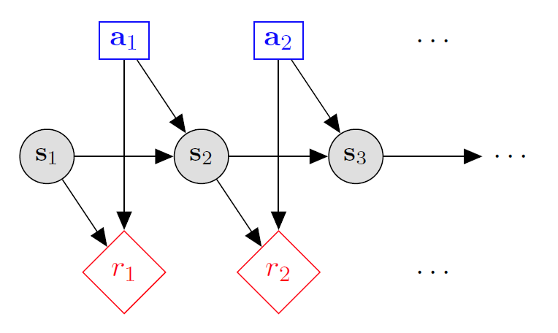

Markov decision processes
States: $s_{1},…,s_{n}$
Actions: $a_{1},…,a_{m}$
Reward Function:
$r\left(s,a,s′\right)∈R$
Transition model:
T(s,a,s’)= $P\left(s′ | s, a\right)$
Discount factor: $γ∈\left[0,1\right]$
<https://en.wikipedia.org/w/index.php?title=Markov_decision_process&oldid=855934986> [accessed 11 September 2018]

Slide 9
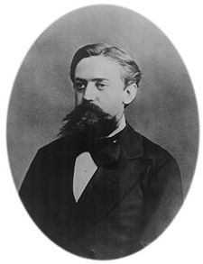
What is Markov about MDPs?
“Markov” generally means that given the present state, the future and the past are independent
For Markov decision processes, “Markov” means action outcomes depend only on the current state
This is just like search, where the successor function only depends on the current state (not the history)
=
Andrey Markov (1856-1922)
Notes:
Like search: successor function only depended on current state
Can make this happen by stuffing more into the state;
Very similar to search problems: when solving a maze with food pellets, we stored which food pellets were eaten

Slide 10
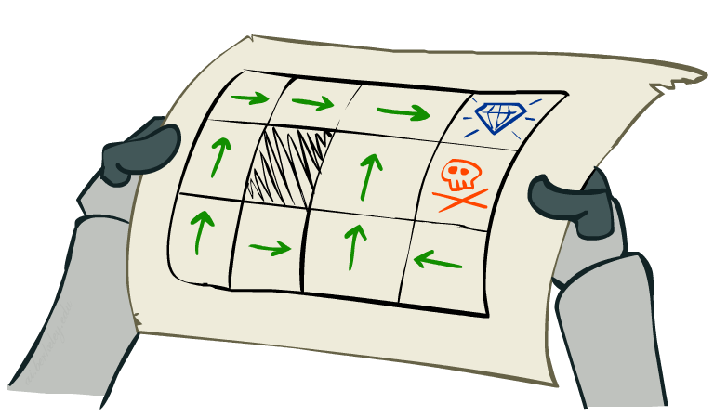
MDP Goal: find an optimal policy π
In search problems, we look for an optimal plan, or sequence of actions, from start to a goal
For MDPs, we want an optimal policy π*: S → A
A policy π gives an action for each state
An optimal policy is one that maximizes expected utility if followed
Notes:
Dan has a DEMO for this.

Slide 11
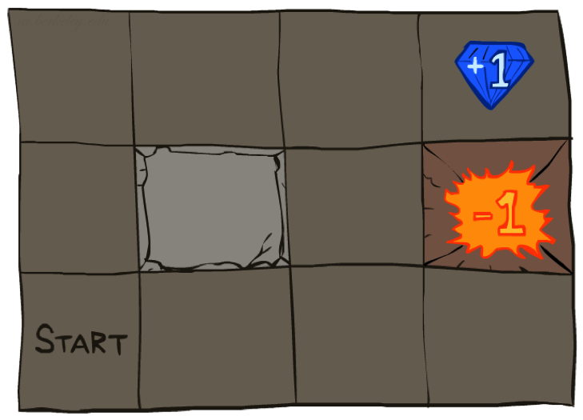




Example: Grid World
A maze-like problem
The agent lives in a grid
Walls block the agent’s path
Noisy movement: actions do not always go as planned
80% of the time, the action North takes the agent North (if there is no wall there)
10% of the time, North takes the agent West; 10% East
If there is a wall in the direction the agent would have been taken, the agent stays put
The agent receives rewards each time step
Small “living” reward each step (can be negative)
Big rewards come at the end (good or bad)
Goal: maximize sum of rewards
Notes:
[cut demo of moving around in grid world program]

Slide 12
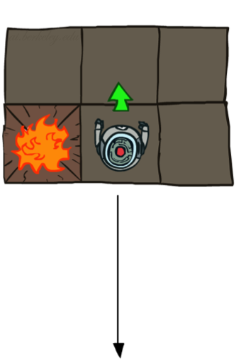
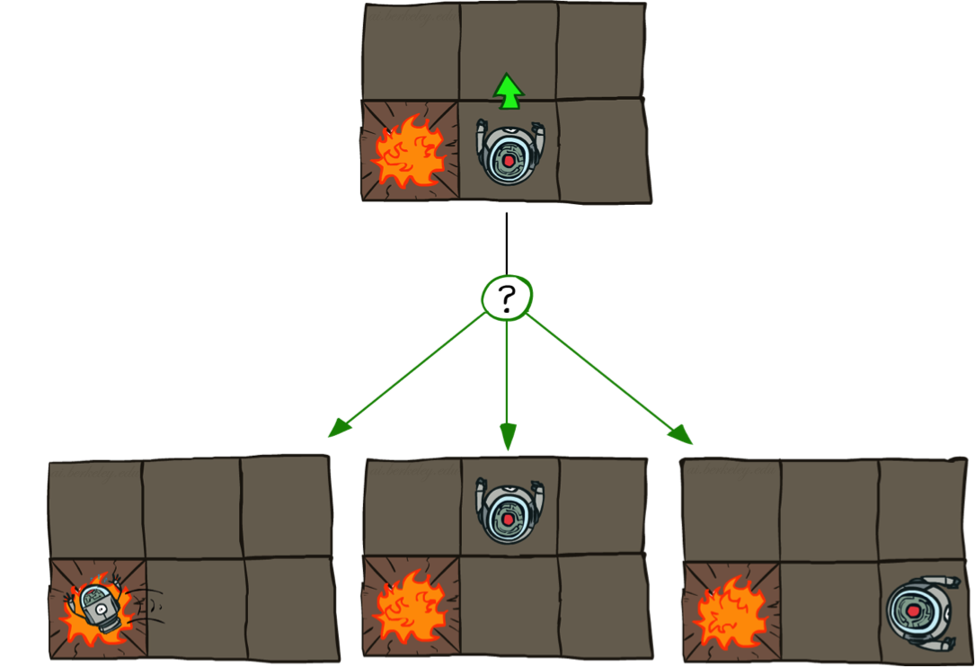
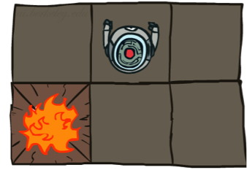
Grid World Actions
Deterministic Grid World
Stochastic Grid World

Slide 13
Optimal Policies
R(s) = -0.01
R(s) = -0.03
R(s) = -0.4
R(s) = -2.0
Notes:
R(s) = the “living reward”

Slide 14
MDP quantities and the bellman equations

Slide 15
MDP Quantities
Markov decision processes:
States S
Actions A
Transitions P(s’|s,a) (or T(s,a,s’))
Rewards R(s,a,s’) (and discount γ)
Start state s₀
Quantities:
Policy = map of states to actions
Utility = sum of discounted rewards
Values = expected future utility from a state (max node)
Q-Values = expected future utility from a q-state (chance node)
s
a
s, a
s,a,s’
s’

Slide 16
Optimal Quantities
The value (utility) of a state s:
V*(s) = expected utility starting in s and acting optimally
The value (utility) of a q-state (s,a):
Q*(s,a) = expected utility starting out having taken action a from state s and (thereafter) acting optimally
The optimal policy:
π*(s) = optimal action from state s
s
s is a state
a
(s, a) is a q-state
s, a
s,a,s’
(s,a,s’) is a transition
s’
[Demo: gridworld values (L9D1)]
Notes:
Demo just shows V and Q values, snapshots on next slides.

Slide 17

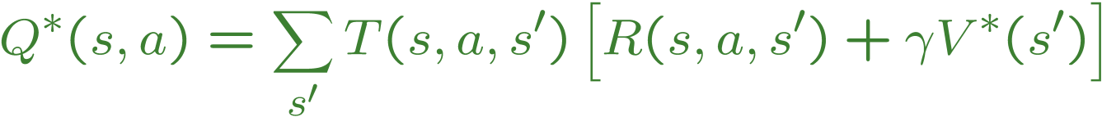

The Bellman Equations
There is one equation $V^{∗}(s)$ for each state s.
There is one equation $Q^{∗}(s,a)$ for each state s and action a.
These are equations, not assignments. They define a relationship, which when satisfied guarantees that $V^{∗}(s)$ and $Q^{∗}\left(s,a\right)$ are optimal for each state and action.
This in turn guarantees that the policy $π^{∗}$is optimal.
s
a
s, a
s,a,s’
s’
Notes:
Let’s start by equations that characterize these quantities through mutual recursions. [step through this by writing on slide, one step at a time]
Recursive characterization of V* in terms of V*; not necessarily helpful; but it is a characterization.
Note: this is a set of equations that needs to be satisfied; but it could have multiple solutions (it does not, but at this stage of our knowledge it could).

Slide 18
4 MDP Algorithms

Slide 19
4 mdp algorithms
Expectimax (recursive, finite horizon)
Value Iteration (dynamic programming, finite horizon)
Value Iteration (dynamic programming, infinite horizon)
Policy Iteration (dynamic programming, infinite horizon,
optimize policy)

Slide 20
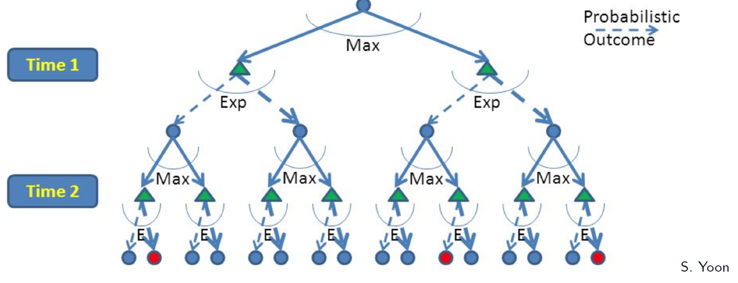
Expectimax: top-down, Recursive
Build out a look-ahead tree to the decision horizon; take the max over actions, expectations over next states.
Solve from the leaves, backing-up the expectimax values.
Finds best move for 1 state

Slide 21
Expectimax: A game against Nature
Expectimax is like a game-playing algorithm except the opponent is nature.
Expectimax is strongly related to the minmax algorithm used in game theory, but the response is probabilistic.
Nodes where you move are called states: S ( )
Nodes where nature moves are called Q-states: <S,A> ( )

Slide 22
Expectimax: top-down, Recursive
Problems:
(1) computation is exponential in the horizon
(2) may expand the same subtree multiple times.

Slide 23
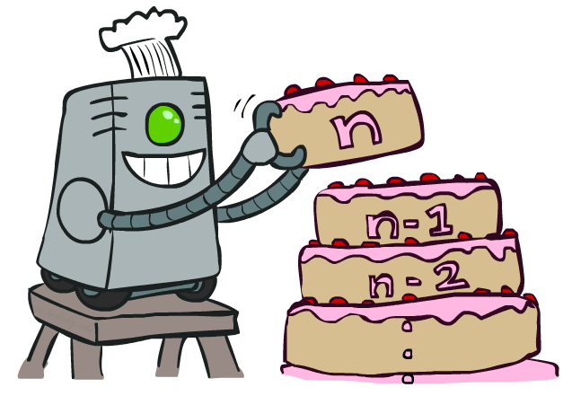
Value Iteration uses dynamic programming

Slide 24

Value Iteration
Start with V₀(s) = 0 - no time steps left means an expected reward sum of zero
Given vector of V_{k}(s) values, do one ply from each state:
$V_{k+1}\left(s\right)←\max_{a}\left[\sum_{s^{′}}{P\left(s^{′} | s,a\right)\left[R\left(s,a,s′\right)+{γV}_{k}\left(s^{′}\right)\right]}\right]$
Repeat until convergence
--------------------------------------------------------------------------------------------
Complexity of each iteration: O(S²A)
For every state s, there are |A| actions
For every state s and action a, there are |S| possible states s’
Theorem: will converge to unique optimal values
Basic idea: approximations get refined towards optimal values
Policy may converge long before values do
V_{k+1}(s)
a
s, a
s,a,s’
V_{k}(s’)
Notes:
Discuss computational complexity: S * A * S times number of iterations
Note: updates not in place [if in place, it means something else and not even clear what it means]

Slide 25
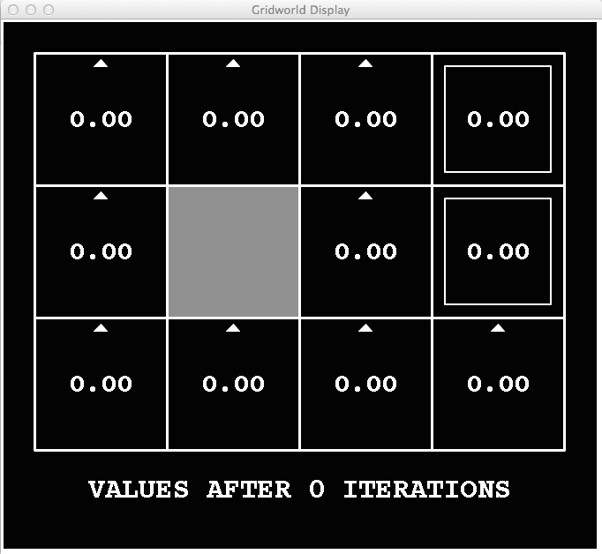
k=0
Noise = 0.2
Discount = 0.9
Living reward = 0
Notes:
Assuming zero living reward

Slide 26
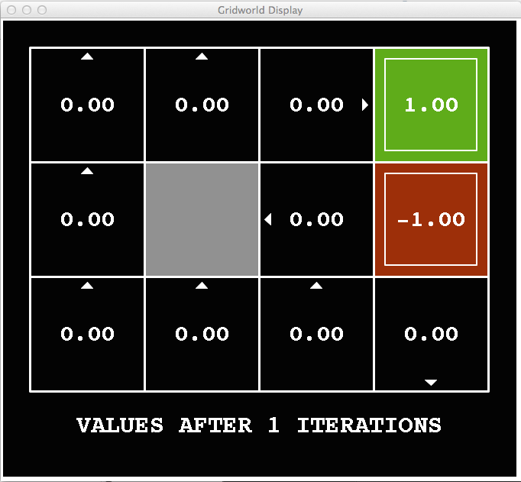
k=1
Noise = 0.2
Discount = 0.9
Living reward = 0
Notes:
Assuming zero living reward

Slide 27
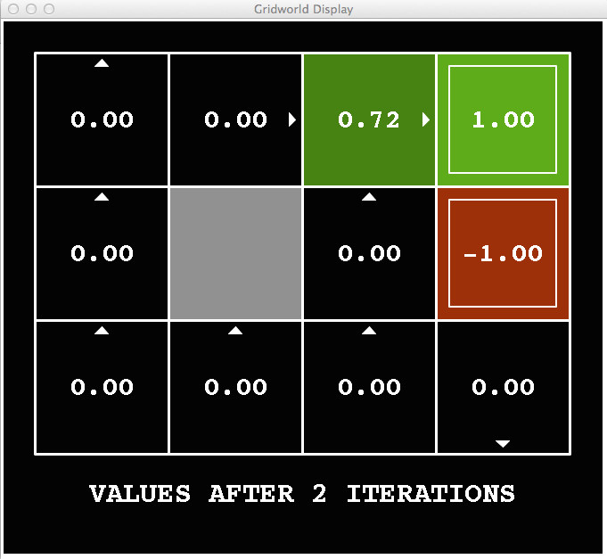
k=2
Noise = 0.2
Discount = 0.9
Living reward = 0
Notes:
Assuming zero living reward

Slide 28
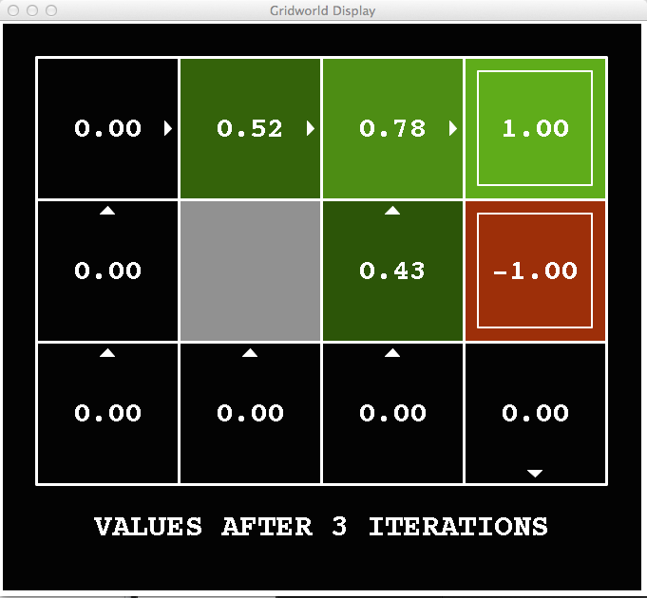
k=3
Noise = 0.2
Discount = 0.9
Living reward = 0
Notes:
Assuming zero living reward

Slide 29
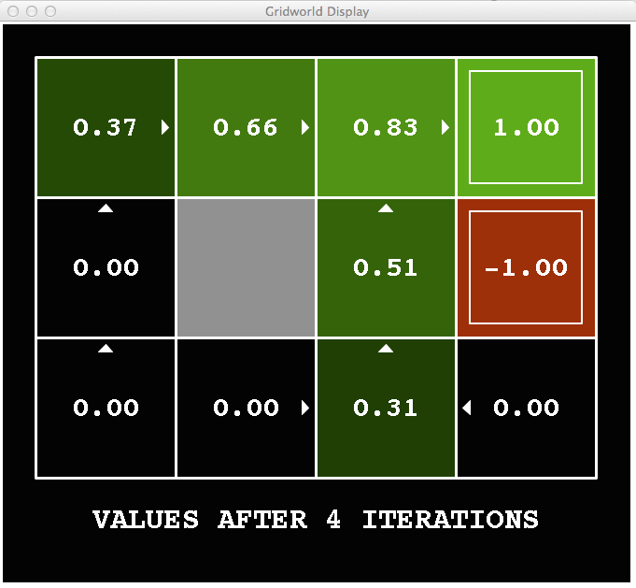
k=4
Noise = 0.2
Discount = 0.9
Living reward = 0
Notes:
Assuming zero living reward

Slide 30
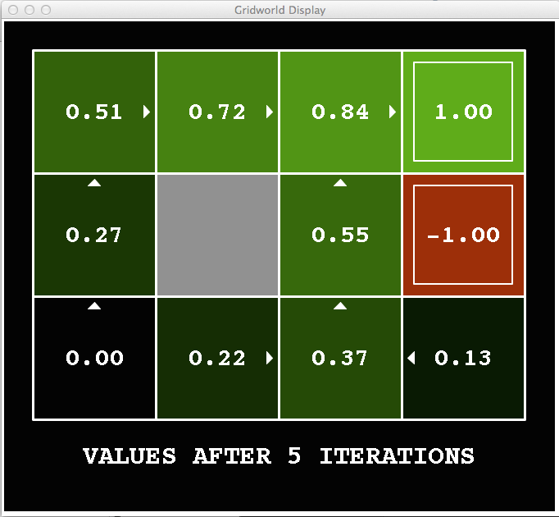
k=5
Noise = 0.2
Discount = 0.9
Living reward = 0
Notes:
Assuming zero living reward

Slide 31
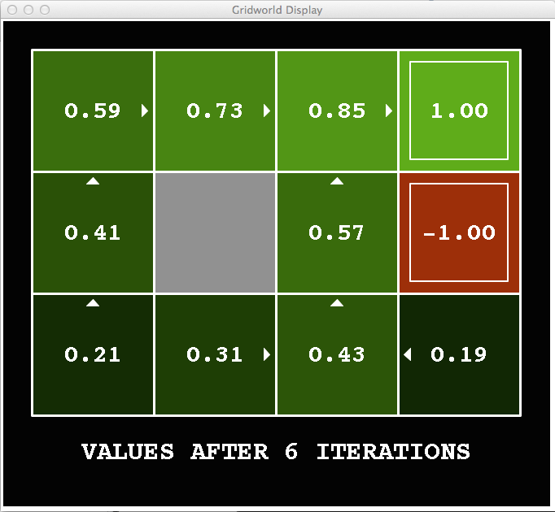
k=6
Noise = 0.2
Discount = 0.9
Living reward = 0
Notes:
Assuming zero living reward

Slide 32
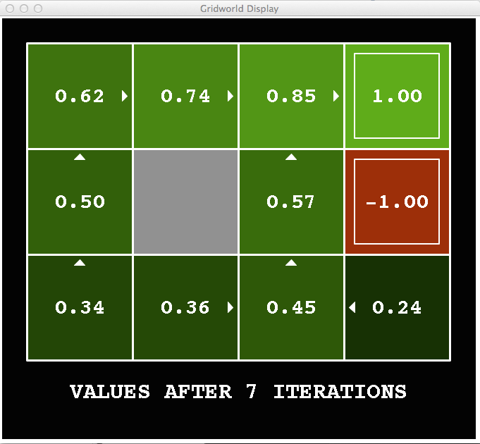
k=7
Noise = 0.2
Discount = 0.9
Living reward = 0
Notes:
Assuming zero living reward

Slide 33
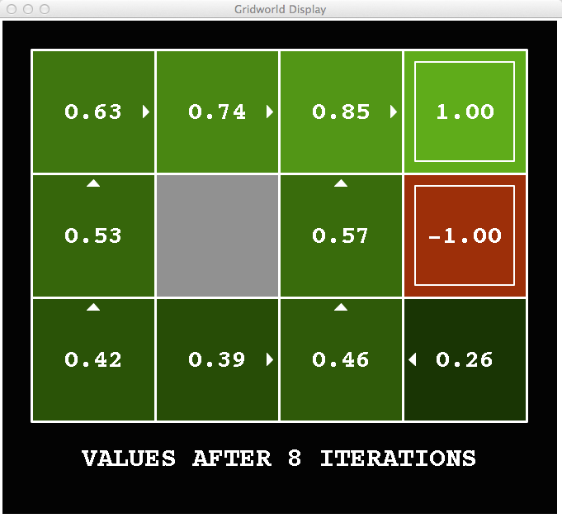
k=8
Noise = 0.2
Discount = 0.9
Living reward = 0
Notes:
Assuming zero living reward

Slide 34
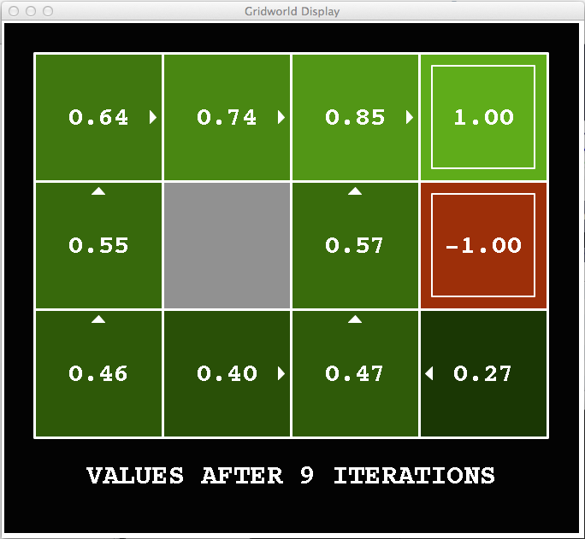
k=9
Noise = 0.2
Discount = 0.9
Living reward = 0
Notes:
Assuming zero living reward

Slide 35

k=10
Noise = 0.2
Discount = 0.9
Living reward = 0
Notes:
Assuming zero living reward

Slide 36

k=11
Noise = 0.2
Discount = 0.9
Living reward = 0
Notes:
Assuming zero living reward

Slide 37
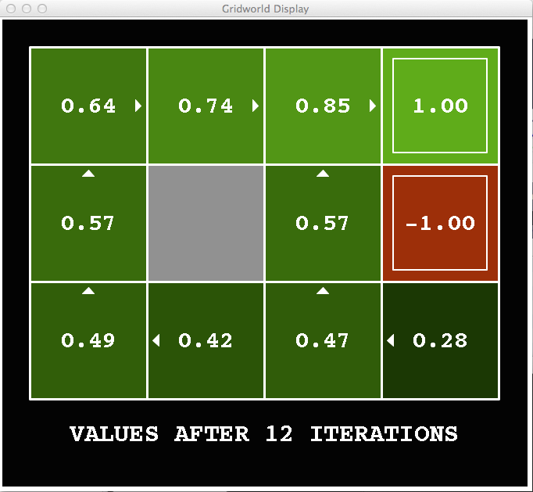
k=12
Noise = 0.2
Discount = 0.9
Living reward = 0
Notes:
Assuming zero living reward

Slide 38

k=100
Noise = 0.2
Discount = 0.9
Living reward = 0
Notes:
Assuming zero living reward

Slide 39
Policy Iteration
Alternative approach for optimal values:
Step 1: Policy evaluation: calculate utilities for some fixed policy (not optimal utilities!) until convergence
Step 2: Policy improvement: update policy using one-step look-ahead with resulting converged (but not optimal!) utilities as future values
Repeat steps until policy converges
This is policy iteration
It’s still optimal!
Can converge (much) faster under some conditions

Slide 40
Policy Iteration
Step 1: Policy Evaluation: For fixed current policy π, find values with policy evaluation:
Iterate until values converge:
Step 2: Improvement: For fixed values, get a better policy using policy extraction:
One-step look-ahead:

Slide 41
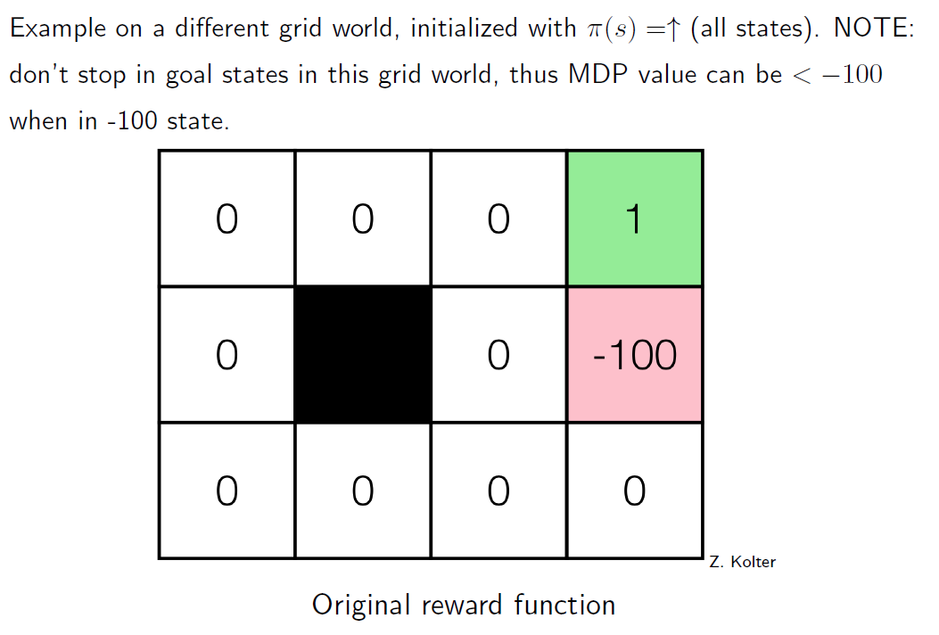
policy iteration Example (0)

Slide 42
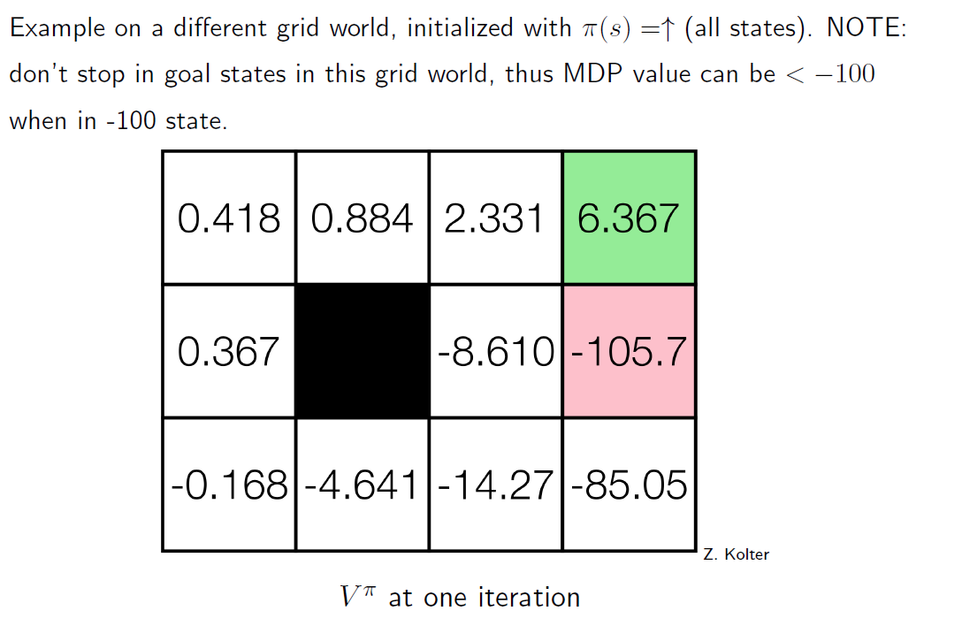
policy iteration Example (1)

Slide 43
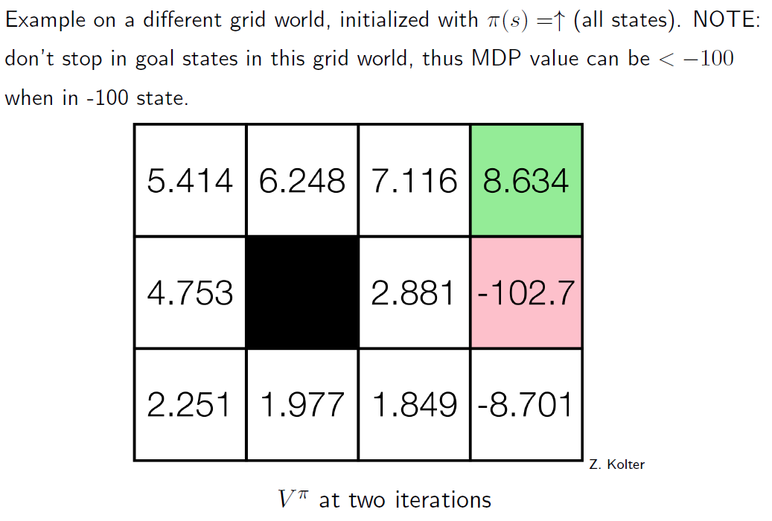
policy iteration Example (2)

Slide 44
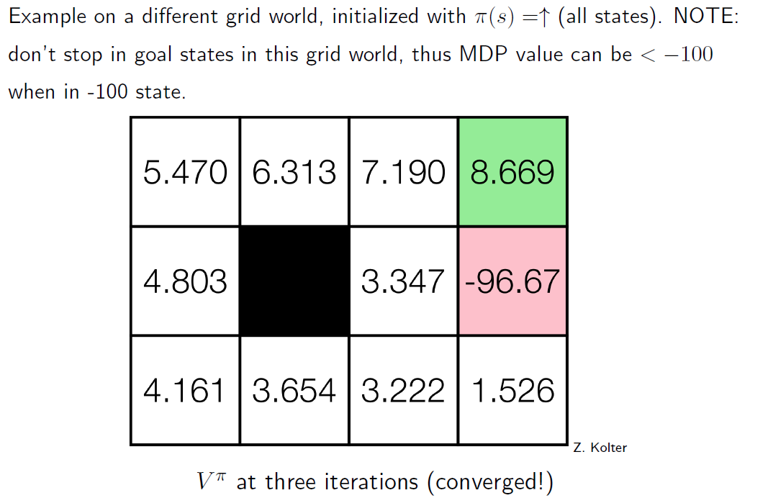
policy iteration Example (3)

Slide 45
Reinforcement Learning

Slide 46
Reinforcement Learning: the basic idea
Select an action
If action leads to reward, reinforce that action
If action leads to punishment, avoid that action
Basically, a computational form of Behaviorism (Pavlov, B. F. Skinner)

Slide 47
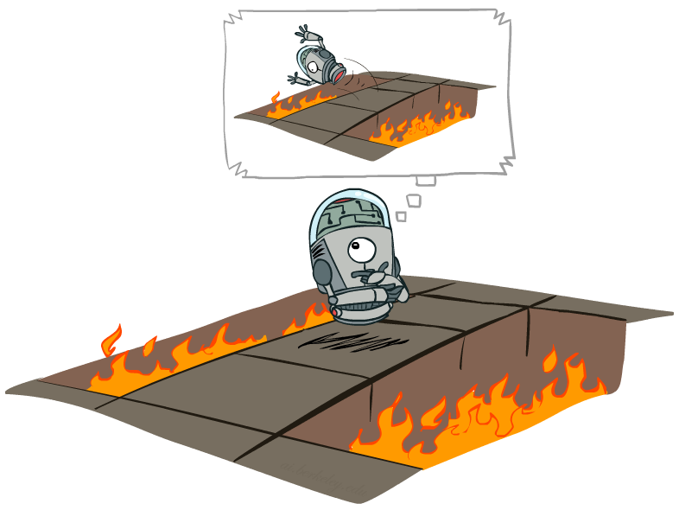
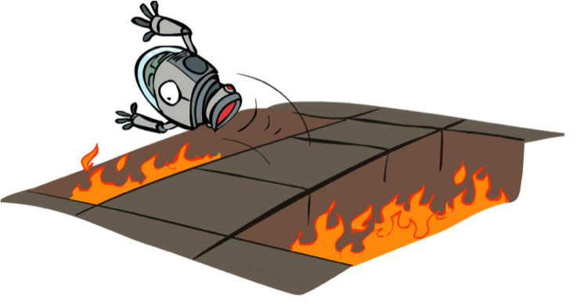
Offline vs. Online
Offline Solution
Online Learning

Slide 48
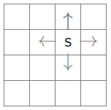
the Learning framework
Learning is performed online, learn as we interact with the world
In contrast with supervised learning, there are no training or test sets. The reward is accumulated over interactions with the environment.
Data is not fixed, more information is acquired as you go.
The training distribution can be influenced by action decisions.

Slide 49
Reinforcement Learning
Agent
State: s’
Reward: r
Actions: a
Environment
Agent knows the current state s, takes action a, receives a reward r and observes the next state s’
Agent has no access to reward model r(s,a) or transition model p(s’|s,a)
Agent must learn to act so as to maximize expected rewards.
All learning is based on observed samples of outcomes!
Under these conditions, it is a very challenging problem to learn the policy π.

Slide 50
Model-based reinforcement learning

Slide 51




Model-Based Learning
Model-Based Idea:
Learn an approximate model based on experiences
Solve for values as if the learned model were correct
Step 1: Learn empirical MDP model
Count outcomes s’ for each s, a
Normalize to give an estimate of
Discover each when we experience (s, a, s’)
Step 2: Solve the learned MDP
For example, use value iteration, as before

Slide 52

Learn the reward and transition distributions
Try every action in each state a number of times
$RTotal\left(s,a,s^{′}\right)=$total reward for taking action a in state s and transitioning to state s’
$N\left(a,s\right)=$ number of times action a is taken in state s
$N\left(s,a,s^{′}\right)=$ number of times s transitions to s’ on action a
$\hat{R}\left(s,a,s^{′}\right)=RTotal(s,a,s^{′})/N(s,a,s^{′})$
$\hat{T}\left(s,a,s^{′}\right)=N(s,a,s^{′})/N(a,s)$

Slide 53
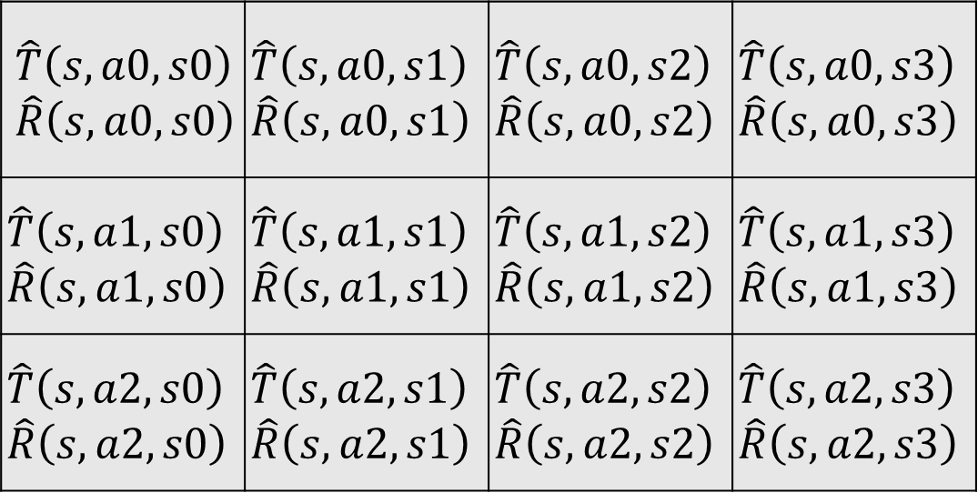
Transition/reward parameter table
For every state s:
State s’
$$\hat{T}\left(s,a0,s0\right)$$ $$\hat{R}\left(s,a0,s0\right)$$ | $$\hat{T}\left(s,a0,s1\right)$$ $$\hat{R}\left(s,a0,s1\right)$$ | $$\hat{T}\left(s,a0,s2\right)$$ $$\hat{R}\left(s,a0,s2\right)$$ | $$\hat{T}\left(s,a0,s3\right)$$ $$\hat{R}\left(s,a0,s3\right)$$
$$\hat{T}\left(s,a1,s0\right)$$ $$\hat{R}\left(s,a1,s0\right)$$ | $$\hat{T}\left(s,a1,s1\right)$$ $$\hat{R}\left(s,a1,s1\right)$$ | $$\hat{T}\left(s,a1,s2\right)$$ $$\hat{R}\left(s,a1,s2\right)$$ | $$\hat{T}\left(s,a1,s3\right)$$ $$\hat{R}\left(s,a1,s3\right)$$
$$\hat{T}\left(s,a2,s0\right)$$ $$\hat{R}\left(s,a2,s0\right)$$ | $$\hat{T}\left(s,a2,s1\right)$$ $$\hat{R}\left(s,a2,s1\right)$$ | $$\hat{T}\left(s,a2,s2\right)$$ $$\hat{R}\left(s,a2,s2\right)$$ | $$\hat{T}\left(s,a2,s3\right)$$ $$\hat{R}\left(s,a2,s3\right)$$
Action a

Slide 54
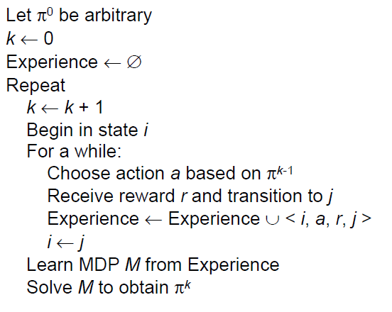
Model-based RL

Slide 55
Model-based rl: Pros and cons
Pros:
Makes maximal use of experience
Solves model optimally, given enough experience
Cons:
Assumes model is small enough to solve
Requires expensive solution procedure

Slide 56
Model-free reinforcement learning: Q-Learning

Slide 57

Q-Learning
Don’t learn a model, learn the Q function directly
Appropriate when model is too large to store, solve or learn
size of transition of model: $O\left(\left|S^{2}\right|\right)$
value iteration cost: $O\left(\left|A\right|\left|S^{2}\right|\right)$
size of Q function $O\left(\left|A\right|\left|S\right|\right)$

Slide 58
Recall The Bellman Equations
s
a
s, a
s,a,s’
s’
Notes:
Let’s start by equations that characterize these quantities through mutual recursions. [step through this by writing on slide, one step at a time]
Recursive characterization of V* in terms of V*; not necessarily helpful; but it is a characterization.
Note: this is a set of equations that needs to be satisfied; but it could have multiple solutions (it does not, but at this stage of our knowledge it could).

Slide 59
From Value Iteration to Q-Value Iteration
Value iteration: find successive (depth-limited) values
Start with V₀(s) = 0, which we know is right
Given V_{k}, calculate the depth k+1 values for all states:
But Q-values are more useful, so compute them instead
Start with Q₀(s,a) = 0, which we know is right
Given Q_{k}, calculate the depth k+1 q-values for all q-states:

Slide 60

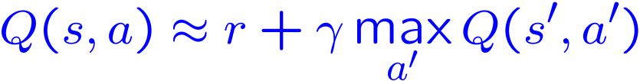
Q-Learning
Q-Learning: sample-based Q-value iteration
Learn Q(s,a) values as you go
Receive a sample transition (s,a,r,s’)
Consider your old estimate:
Consider your new sample estimate:
Incorporate the new estimate into a running average:

Slide 61

Q-Learning update rule
On transitioning from state s to state s’ on action a, and receiving reward r, update:
$α$ is the learning rate
a large $α$ results in quicker learning, but may not converge.
$α$ is often decreased as learning goes on.

Slide 62


relation to exponential Smoothing
The Q-Learning update rule is similar to a times series technique called exponential smoothing.
the simplest form of exponential smoothing is given by the formulas:
where $α$ is the decay rate.
https://en.wikipedia.org/w/index.php?title=Exponential_smoothing&oldid=861463311 referenced on 10/3/2018

Slide 63
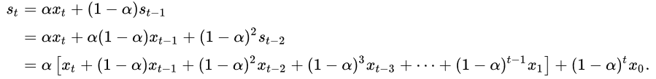

exponential Smoothing (2)
As time progresses, the affect on $s_{t}$ of more remote terms decay exponentially as they recede into the past.
The above equations can be expanded thus:
https://en.wikipedia.org/w/index.php?title=Exponential_smoothing&oldid=861463311 referenced on 10/3/2018

Slide 64
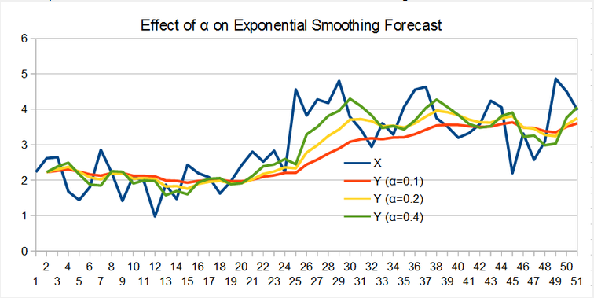
exponential Smoothing Example
Notice how Curves become more “wiggly” as 𝛼 increases.
http://www.edscave.com/forecasting---exponential-smoothing.html referenced on 10/3/2018

Slide 65

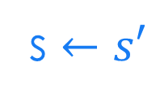
Q-Learning algorithm
For each state s and action a:
$Q\left(s,a\right)←0$
Begin in state s:
Repeat:
For all actions associated with state s, choose action a based on the Q values for state s
Receive reward r and transition to s’
s $←s′$

Slide 66
Choosing the Action
Learned Q function determines the policy
in state s, choose action with largest Q(s,a)
Still have to worry about exploration vs. exploitation.
use techniques we discussed last week.

Slide 67

Exploration risk
Assume we’re using decreasing $ε$-exploration or simulated annealing.
What if the optimal policy involves walking along the edge of a cliff?
What happens during the early stages of learning?

Slide 68
Exploration risk
Update rule:
Q-value is updated based on the best action.
But if we’re exploring a lot, we won’t always do the best action.
We will fall off the cliff a lot!
We would like to take advantage of our experience on the cliff to prevent this from happening more than necessary!

Slide 69

Next Time: More Model-free RL
more Q-Learning
SARSA-Learning – addresses problem of falling off the cliff too often.
TD($λ$)
Generalization
Deep Q-Learning?

